Slide 1
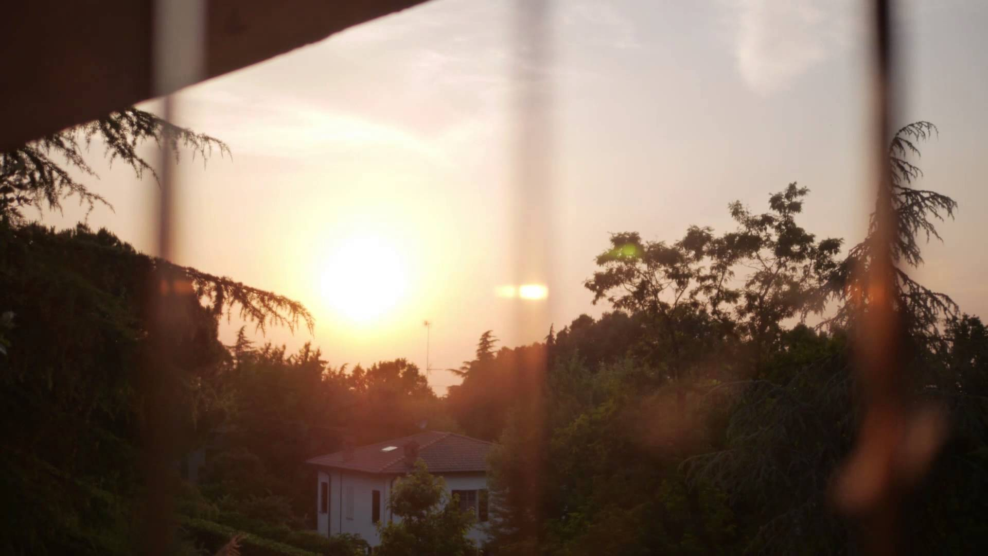
Hipster Life
A website by Vince Liem, Jelmer Rotteveel, Nick Dovianus and Louise Oprel

Slide 2

The concept
Hipster Life is created with the purpose of making hipster lives healthier, easier and hipster
from Hipsters - for Hipsters

Slide 3

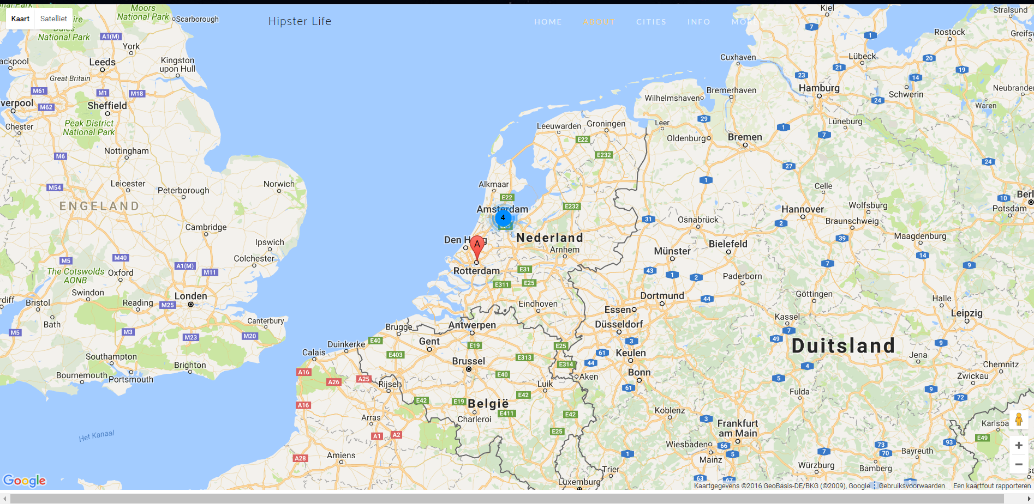
Real-time Hipster Cities

Slide 4


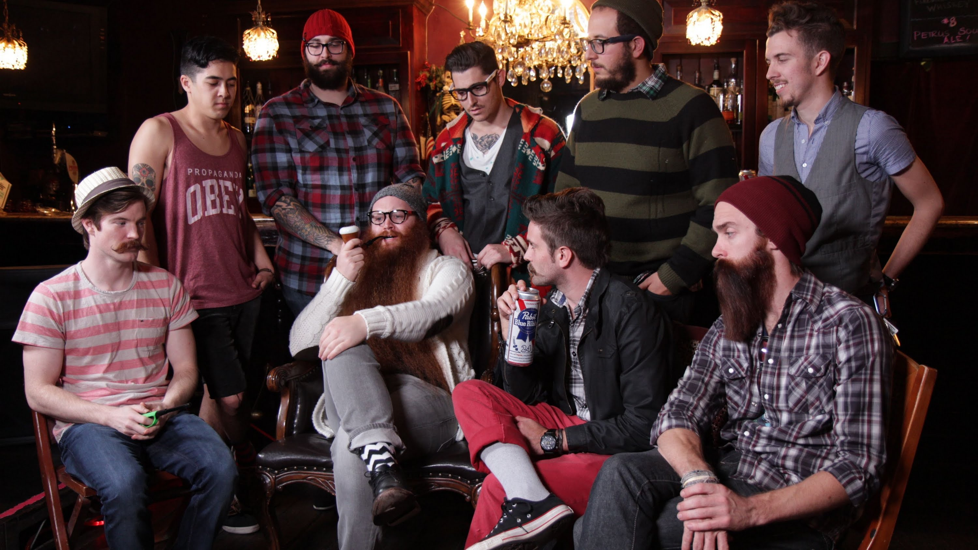




Hipster Imagination Get inspired to the next level!

Slide 5


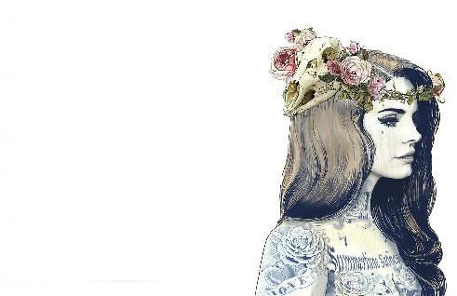

Hipster News All about the Hipster community
politics
Starbucks
charging stations
tattoos

Slide 6

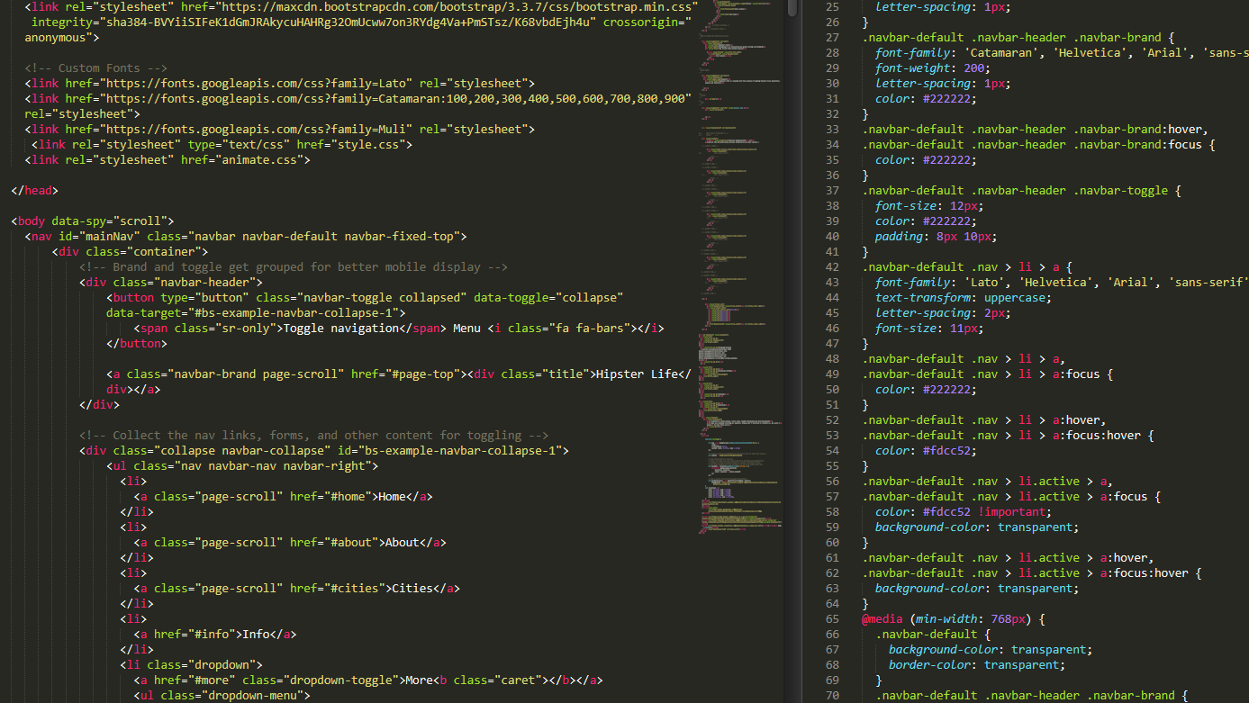
The Front-End
1 css, 2 html, 5 js, 1 api, ….
1 website

Slide 7

Demo Time

Slide 8
Questions?

